Slide 1
Dutch best practice
Publishing metadata about geographic information as Linked Data
Marco Brattinga & Ine de Visser

Slide 2
European Datasets are hot
https://www.europeandataportal.eu
http://inspire-geoportal.ec.europa.eu

Slide 3
Dutch Datasets are hot
https://data.overheid.nl
https://www.nationaalgeoregister.nl

Slide 4
METADATA STANDARDS
RDF Linked Data
XML
W3c DCAT 1.0
ISO 19115:2003
DCAT-AP-EU v1.1
Inspire MD TG v2.0
GeoDCAT AP 1.0.1
MD NL 19115 v2.0.0
DCAT-AP-NL v1.1

Slide 5
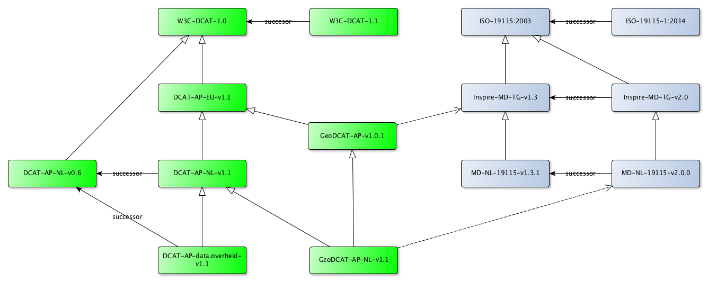
IT GETS WORSE

Slide 6
IT’S EVEN WORSE
~60 pages
178 pages
30 pages
~30 pages

Slide 7
/DIFF ??

Slide 8

One DATASET?

Slide 9
Ambition
One unique source for metadata of any particular dataset
Source might be RDF-oriented or XML-oriented (it should not matter)
Machine & Human readable metamodel specification (not a PDF)
Enabling machine translatable metadata between standards and catalogues

Slide 10
APROACH
Create a SHACL model for all standards
DCAT, DCAT-AP-EU, GeoDCAT-AP
Inspire Technical guidelines, Dutch MD profile
Compare standards by creating links between elements
Identify problem-areas and propose solutions

Slide 11
SHACL
http://bp4mc2.org/dcat/dcat/
https://www.w3.org/TR/shacl
https://shacl.org

Slide 12
Compare
inspire-shape:ResourceTitle a sh:PropertyShape;
shxl:index 1;
dct:subject inspire-concept:ResourceTitle;
sh:path dct:title;
sh:name "title";
rdfs:label "Resource title"@en;
rdfs:label "Titel van de bron"@nl;
sh:severity sh:Violation;
sh:datatype xsd:string; #CharacterString
sh:node inspire-shape:FreeText;
sh:minCount 1;
sh:maxCount 1;
inspire-meta:isoref "360. title";
inspire-meta:xpath "identificationInfo[1]/*/citation/*/title";
skos:example "SPI: Standardized Precipitation Index";
.

Slide 13
IDENTIFY PROBLEM AREAS
URI references versus tekst
Codelists: different taxonomies
Missing information or more complex information structures

Slide 14
WRAP UP
We should have one metamodel for open and geospatial datasets;
Every metadata specification should have a machine and hum an readable specification;
SHACL is a good candidate for the specification of these metamodels (and can be translated with some effort to other schema specifications, like xsd or uml class diagrams)
Getting to 100% is hard, but achievable on – at least – a national level.
We’re not their - yet

